Slide 1
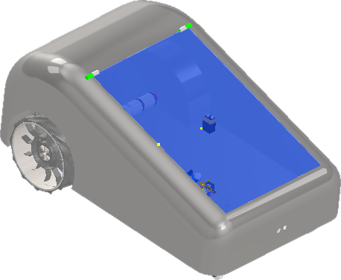
DIP VI · ENGLISH SEMINAR
Solugarden
An integrated factory for the Autonomous Gardener Robot
Alecsander Melo Nunes da Silva
Carlos Augusto Kice
Gabriel Ricardo da Silva
Jacson Sena Reis
Fatec São Bernardo do Campo · Advanced Manufacturing · 2026
Notes:
Speaker: Alecsander. Good evening, everyone. We are Solugarden, and today we will present our integrated project for the sixth semester. Our company manufactures the Gardener Robot, an autonomous electric lawn mower. We will show the product, the factory, safety, logistics, automation, augmented reality and our engineering simulation.

Slide 2
02 · THE PRODUCT
Meet the Gardener Robot
20 kg
2 × 250 W
design weight
DC gear motors
Ø 280 mm
18 V
wheels at 25 rpm
Li-ion battery
Ultrasonic, infrared, tilt and lift sensors keep it safe around people and pets.
Notes:
Speaker: Alecsander. This is our product. It weighs about twenty kilograms and is driven by two 250-watt gear motors. The wheels have 280 millimetres and turn at 25 rpm. It runs on an 18-volt lithium-ion battery, and its sensors stop the blades if someone lifts or tilts the robot.

Slide 3





03 · MANUFACTURING
From receiving to shipping
Receiving
CNC machining
Assembly
Quality & test
Shipping
484 min
of work content in every robot
36 %
of it is assembly – our focus
Notes:
Speaker: Carlos. Our process has five main stages: receiving, CNC machining, assembly, quality and testing, and shipping. Each robot needs about 484 minutes of work. Assembly is the longest stage, with 173 minutes, so it is where automation and augmented reality bring the biggest gains.

Slide 4
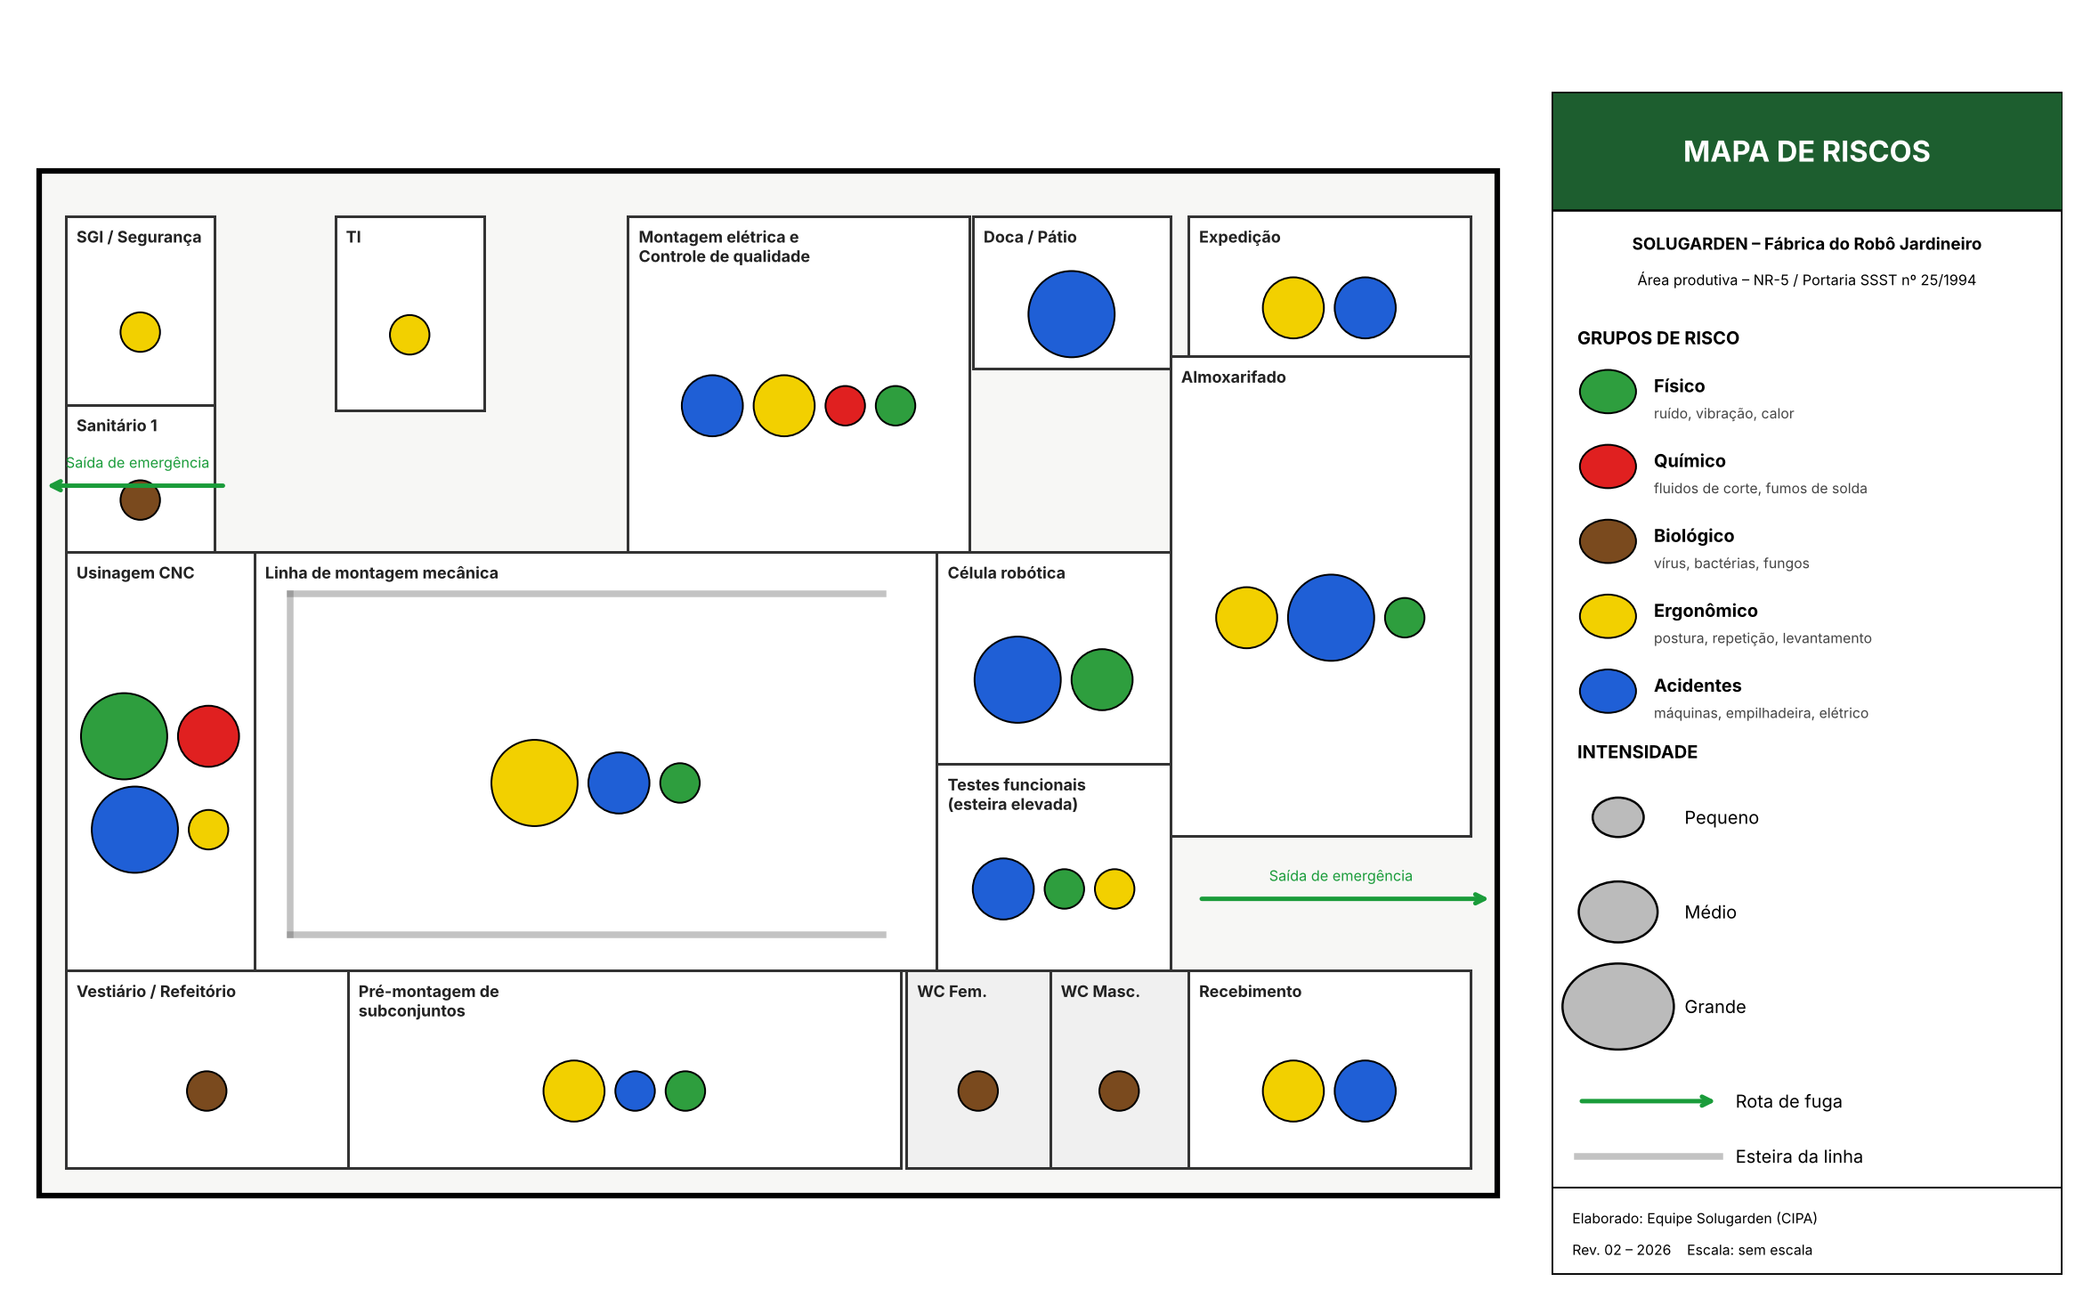
04 · SAFETY
Mapping the risks on the shop floor
Guards and light curtains (NR-12)
Marked forklift lanes
Adjustable workbenches
Notes:
Speaker: Carlos. We built a new risk map of the production area. Circle colours show the risk group and circle size shows intensity. Accident and ergonomic risks are the most frequent. To control them we proposed guards and light curtains, marked forklift lanes and adjustable workbenches.

Slide 5


05 · SUSTAINABILITY
Green product, green process
Electric product
Cleaner deliveries
Battery take-back
No fuel and no exhaust gases. A quiet mower that can work in condominiums at any time.
Electric vans for local deliveries and returnable packaging between suppliers and the plant.
Used Li-ion batteries come back to us for recycling, as Law 12,305/2010 requires.
Notes:
Speaker: Carlos. Sustainability is part of the product itself. The robot is electric, so it has no fuel and no exhaust. Deliveries use electric vans and returnable packaging. And at the end of their life, batteries come back to us through reverse logistics, as Brazilian law requires.

Slide 6
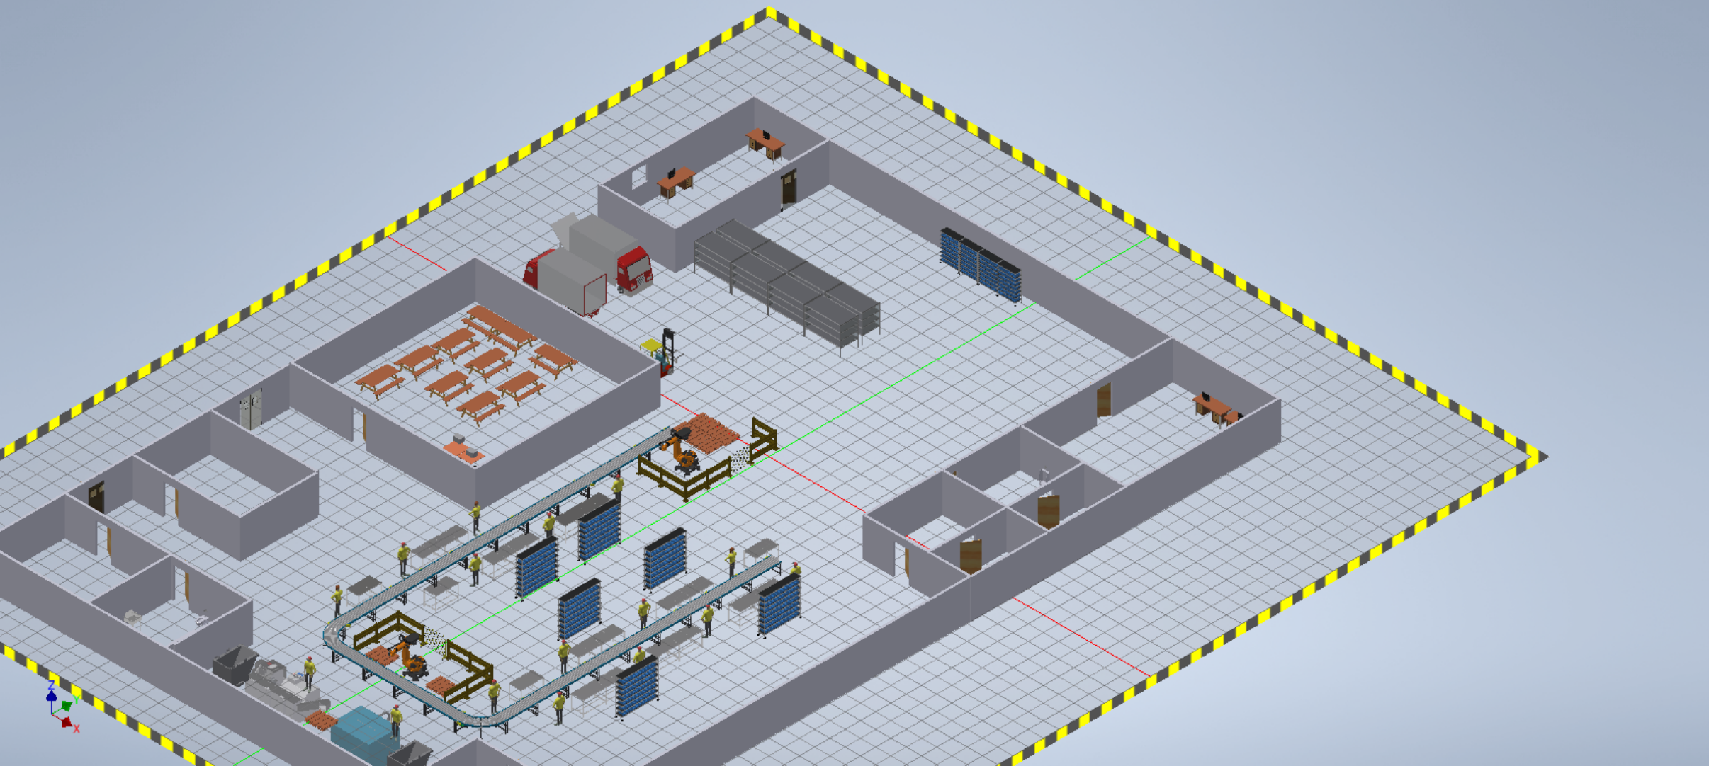



06 · PRODUCTION MANAGEMENT
A hybrid layout with pull production
Hybrid layout
Loop assembly line plus cells for CNC and robotics
Pull system
Repetitive batches triggered by real orders
Balanced line
10.8
41.7 min
Work split so no station waits
robots per shift
takt between robots
Notes:
Speaker: Gabriel. Our layout is hybrid. The assembly is a product layout, a loop line, while machining and palletizing are organised in cells. Production is repetitive and pulled by orders. The line delivers about 10.8 robots per shift, one every 41.7 minutes.

Slide 7



07 · LOGISTICS
The right part, at the right time
Milk run
Kanban
Line supply every 30 min
Cards trigger replenishment
FIFO
ESD care
Oldest batteries leave first
Protected electronics storage
Motors, battery and cutting set = 75 % of cost
Notes:
Speaker: Gabriel. Inside the plant, a milk run supplies the line every thirty minutes and kanban cards trigger replenishment. Batteries follow FIFO, and electronics are stored with ESD protection. The ABC analysis shows that only three items, the motors, the battery and the cutting set, represent 75 percent of the cost, so they get the tightest control.

Slide 8
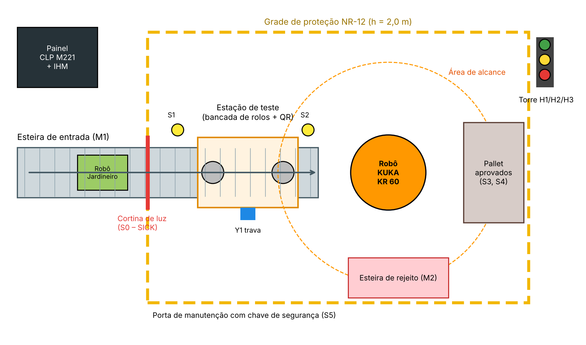
08 · AUTOMATION
A test and palletizing cell
104 s
cycle time per robot
14 / 10
PLC inputs / outputs
KR 60
KUKA robot palletizer
0
manual lifts of 20 kg
Notes:
Speaker: Jacson. This cell tests every robot and puts it on a pallet. A PLC with fourteen inputs and ten outputs controls a conveyor, a test station and a KUKA KR 60 robot, and the operator uses an HMI. The cycle takes 104 seconds and nobody needs to lift the 20-kilogram robot by hand.

Slide 9

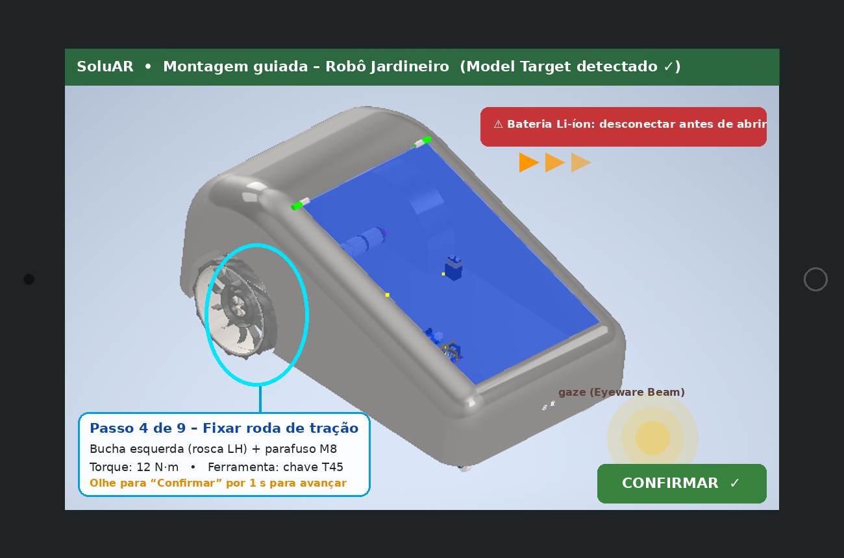


09 · AUGMENTED REALITY
SoluAR: guided assembly
Blender
Light 3D models and step animations
Vuforia Model Target
Recognises the real robot on the bench
Eyeware Beam
Look at “Confirm” to go hands-free
Notes:
Speaker: Jacson. SoluAR is our augmented reality app. CAD models are prepared in Blender, Vuforia recognises the real robot and the app shows each assembly step in 3D, with the right part, tool and torque. With Eyeware Beam eye tracking, the operator confirms a step just by looking at the button, with no need to touch the screen.

Slide 10
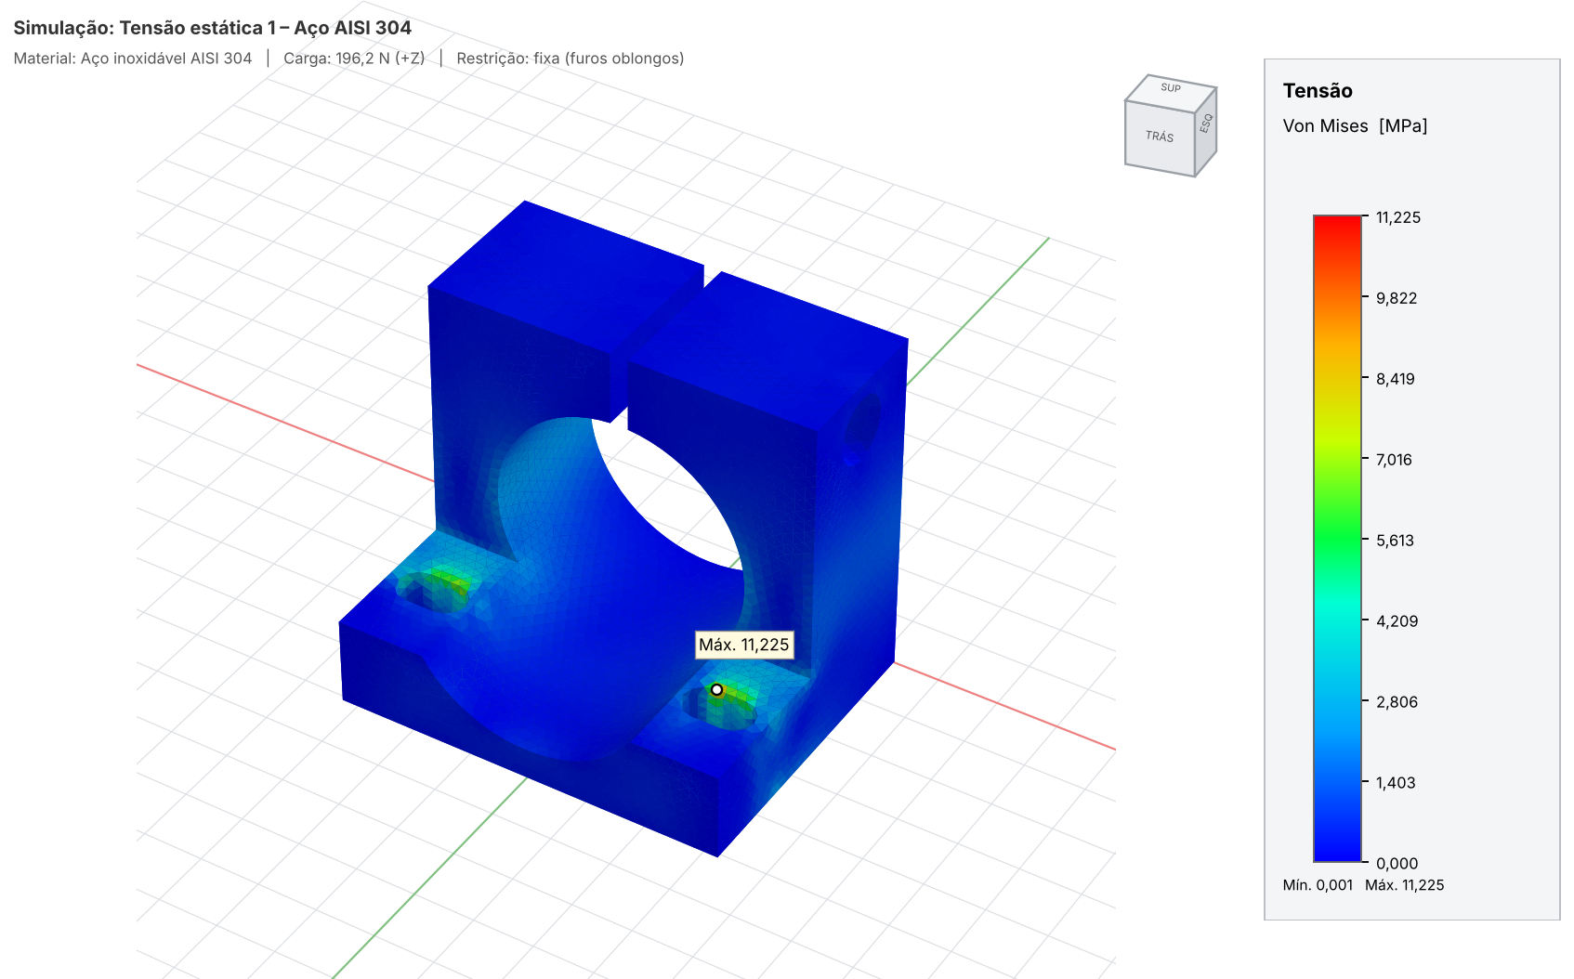
10 · CAE STUDY
Simulating the motor bracket
Load: 196 N upward (20 kg)
Fixed: 2 base screw slots
Material: AISI 304 steel
11.2
0.003
MPa max stress
mm max displ.
FS ≈ 19
safety factor: the part is oversized
Notes:
Speaker: Alecsander. For the CAE study we chose the bracket that holds the traction gear motor. The robot weight pushes it up with 196 newtons while it is fixed by two screws. With a refined mesh, the maximum stress is only 11.2 megapascals and the safety factor is about 19. Coarse and refined meshes differed by only 3 percent, so the result is reliable, and it shows the part is oversized.

Slide 11
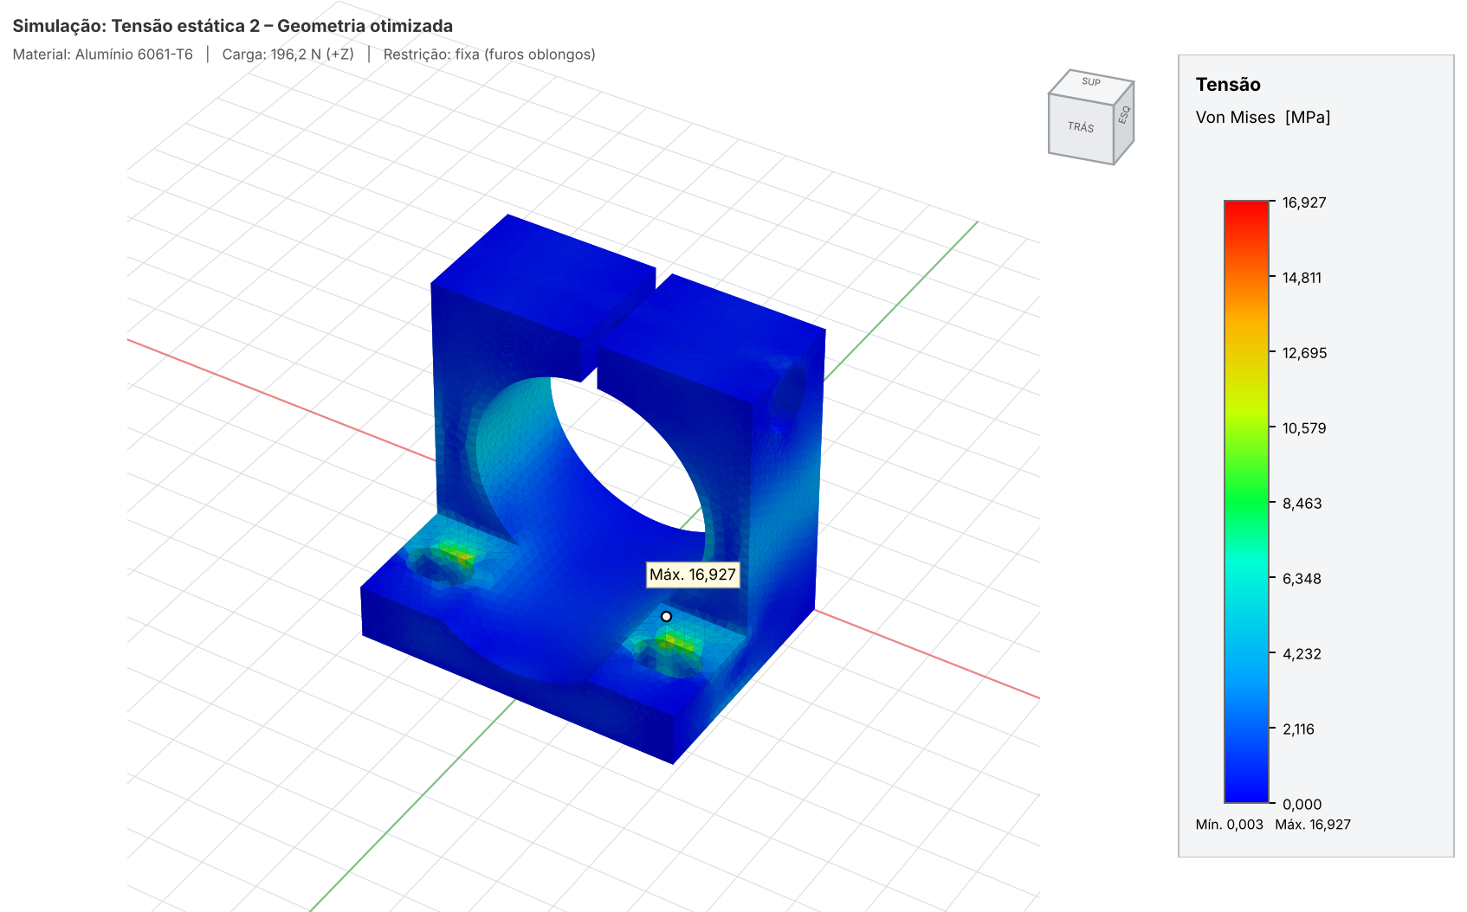
11 · OPTIMIZATION
Smaller, lighter, cheaper
−79 %
mass: 608 g → 126 g
−68 %
raw material cost
FS 16.2
still very safe in aluminum 6061-T6
Notes:
Speaker: Gabriel. Because the bracket was oversized, we reduced its width, height, depth and base thickness, and changed the material to aluminum 6061-T6. The new part is 79 percent lighter and 68 percent cheaper in raw material, and the safety factor is still 16. We also tested 3D-printed PLA: it passes, but it is only suitable for prototypes because of heat and creep.

Slide 12
12 · CONCLUSION
Thank you!
A safe, lean and greener factory
Automation and AR support people
Simulation turned data into savings
Questions?
Notes:
Speaker: all members. To sum up, we designed a factory that is safe, lean and greener. Automation and augmented reality support the operators instead of replacing them, and the simulation turned engineering data into real savings. Thank you very much for your attention. Do you have any questions?

